Slide 1
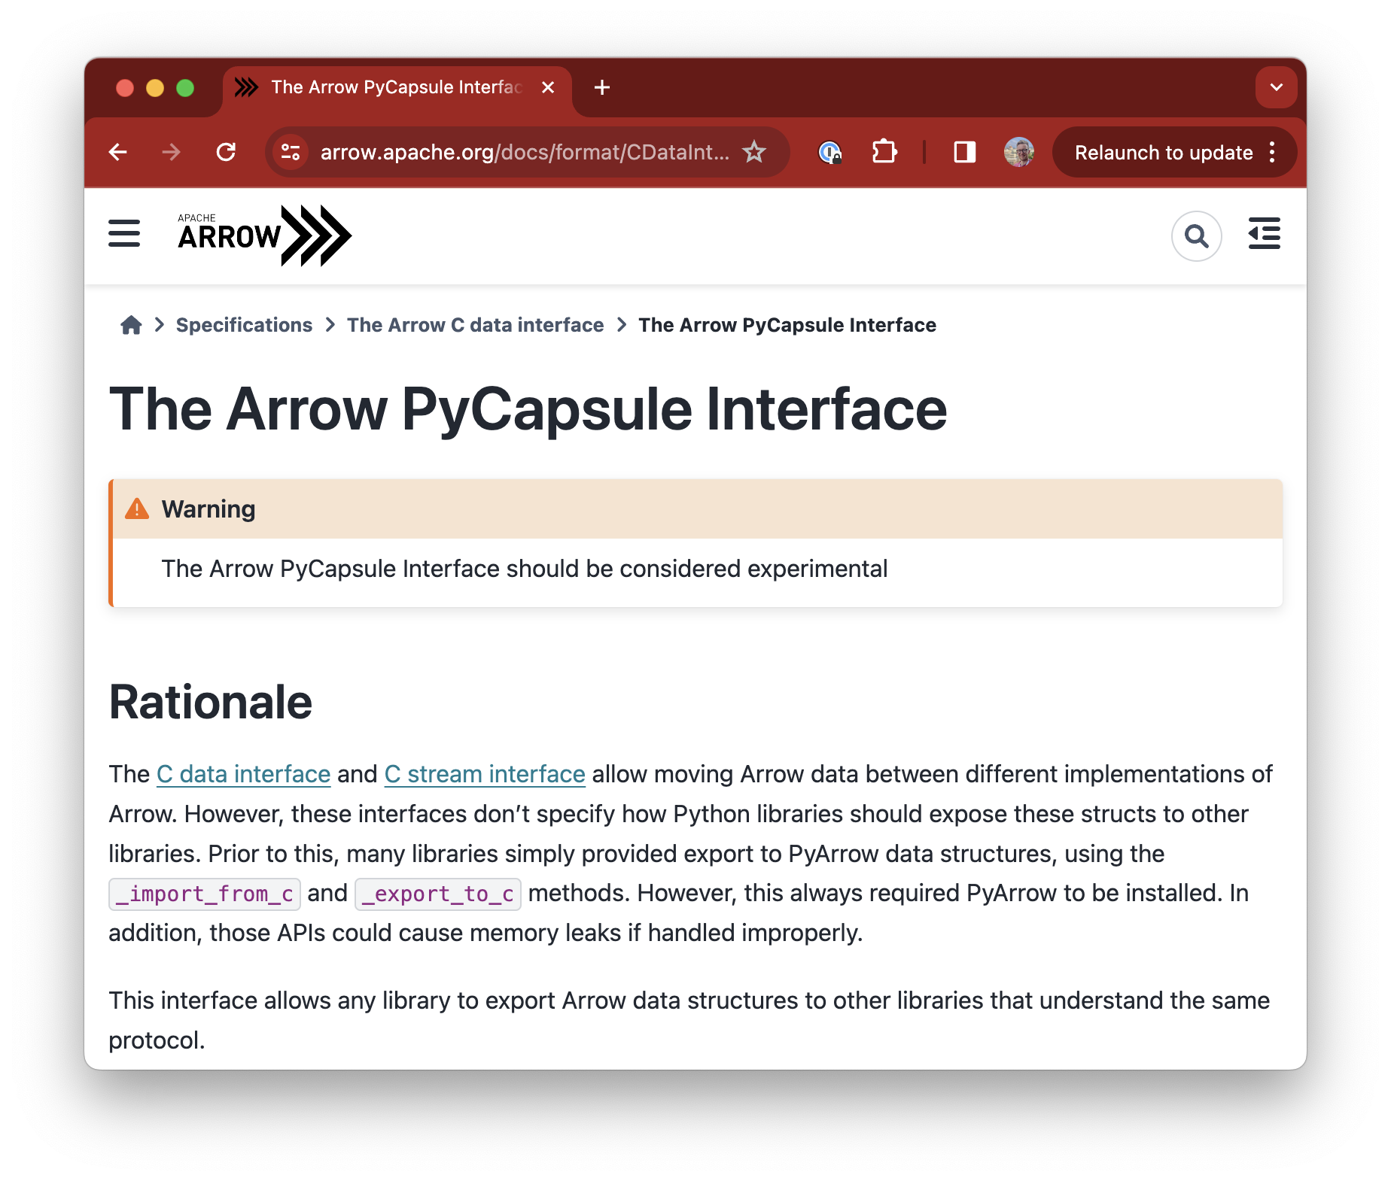



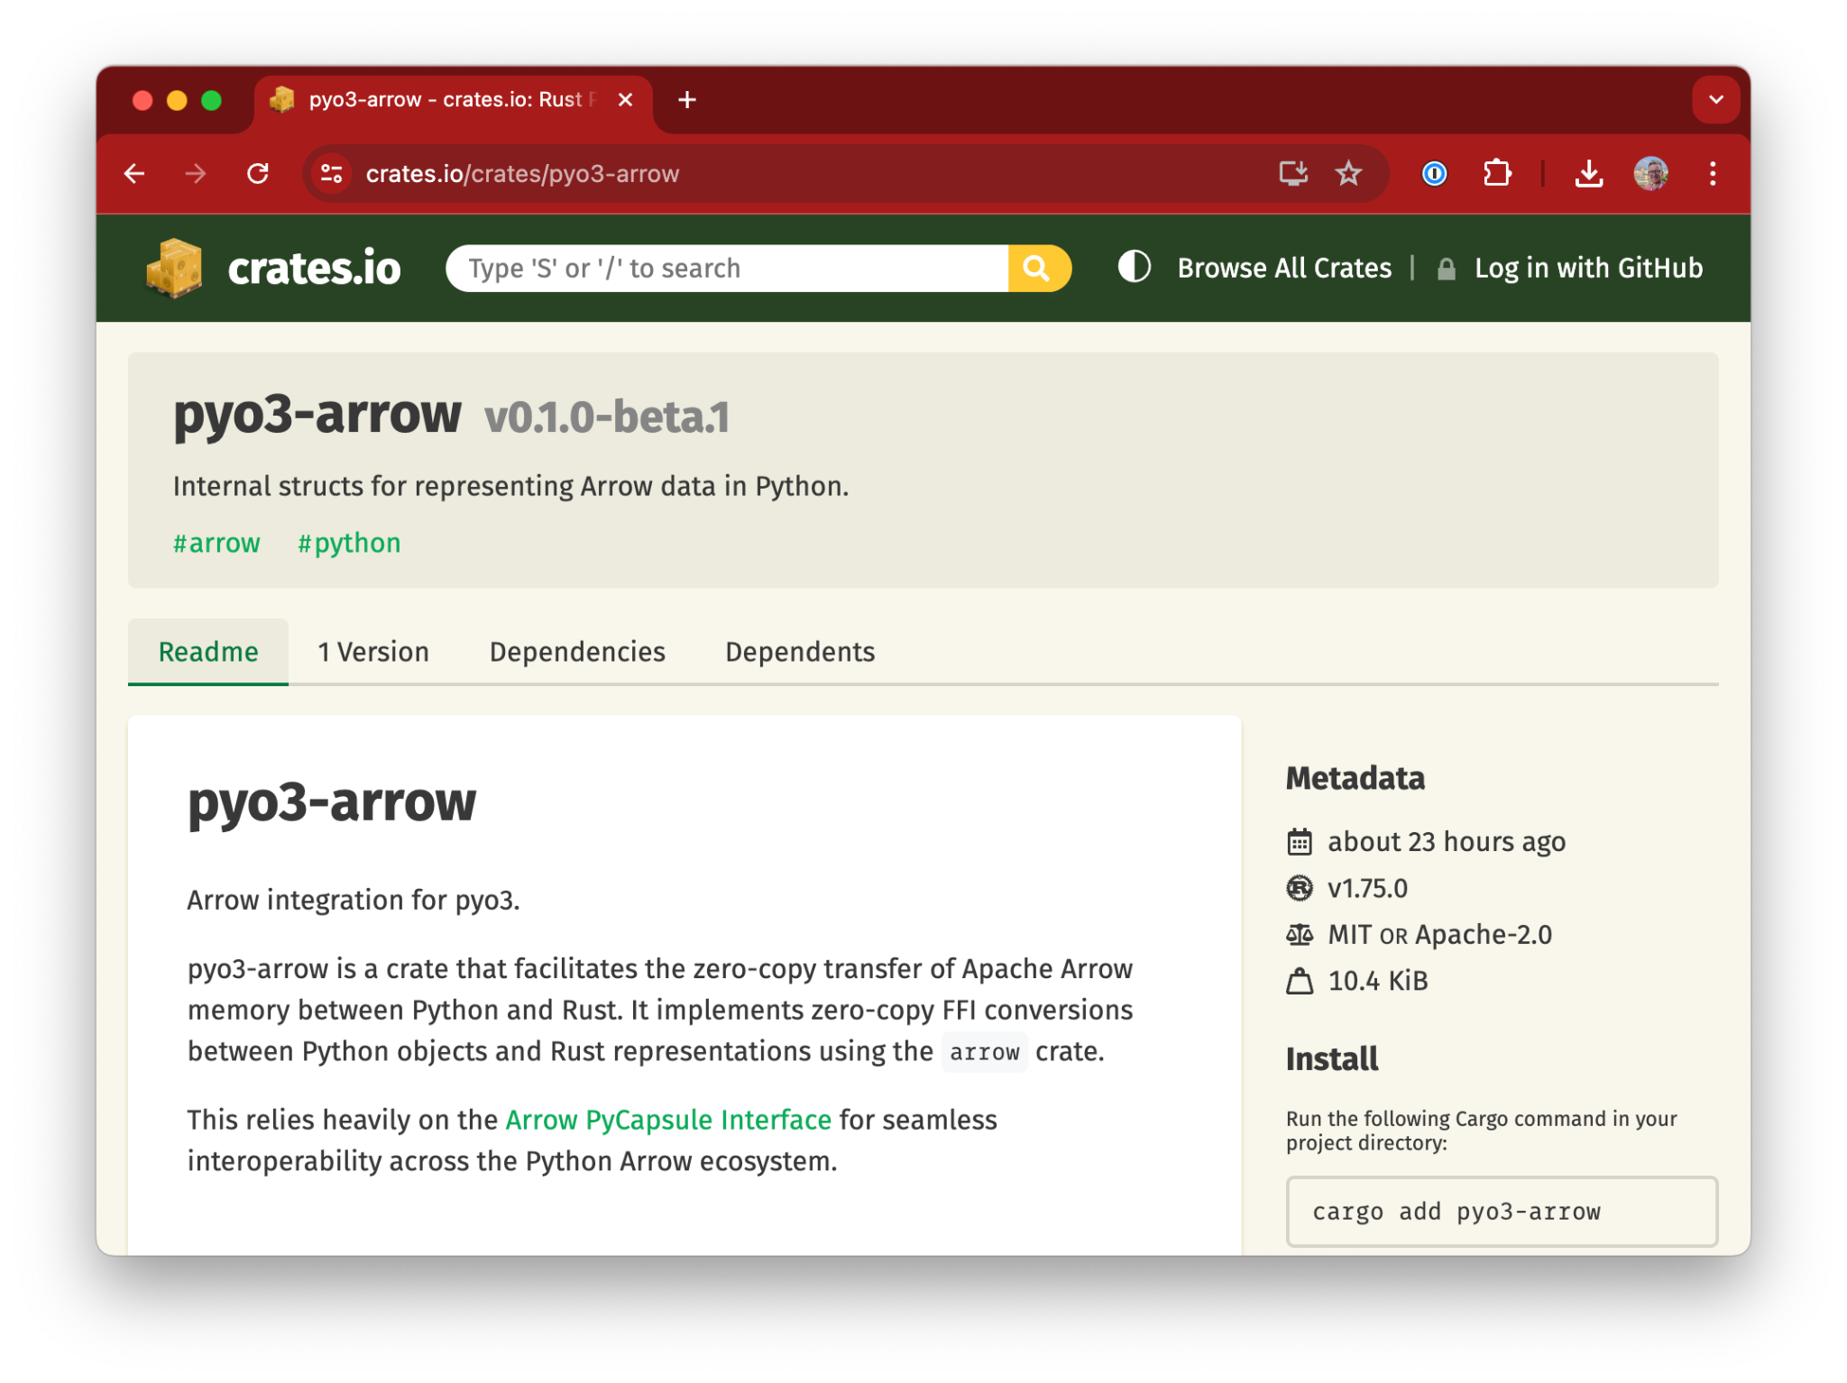
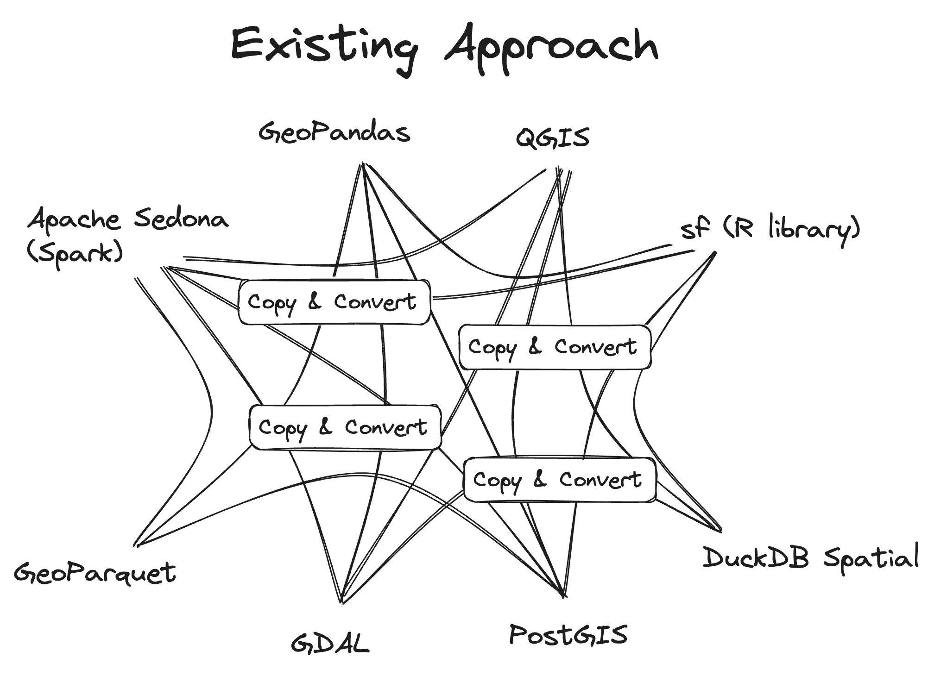
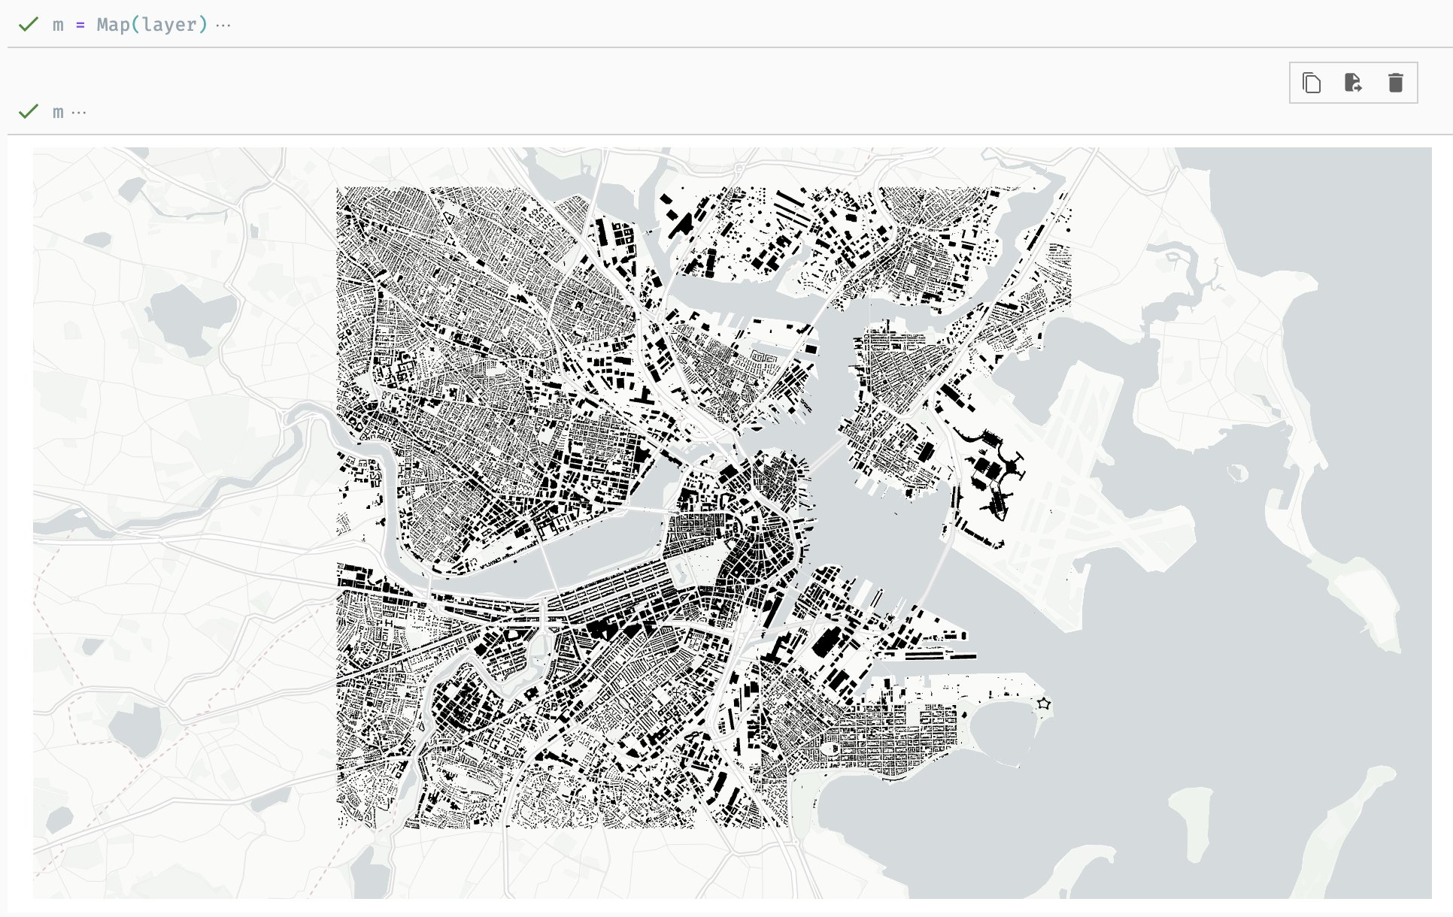
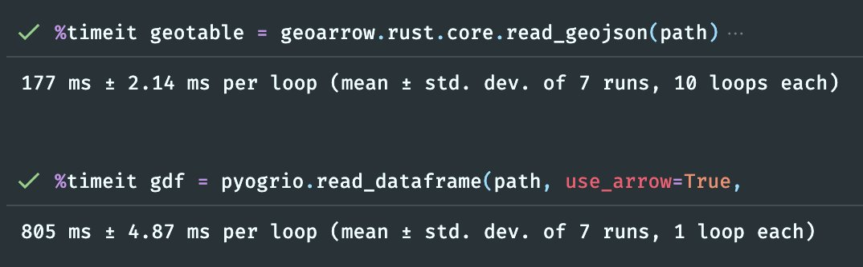
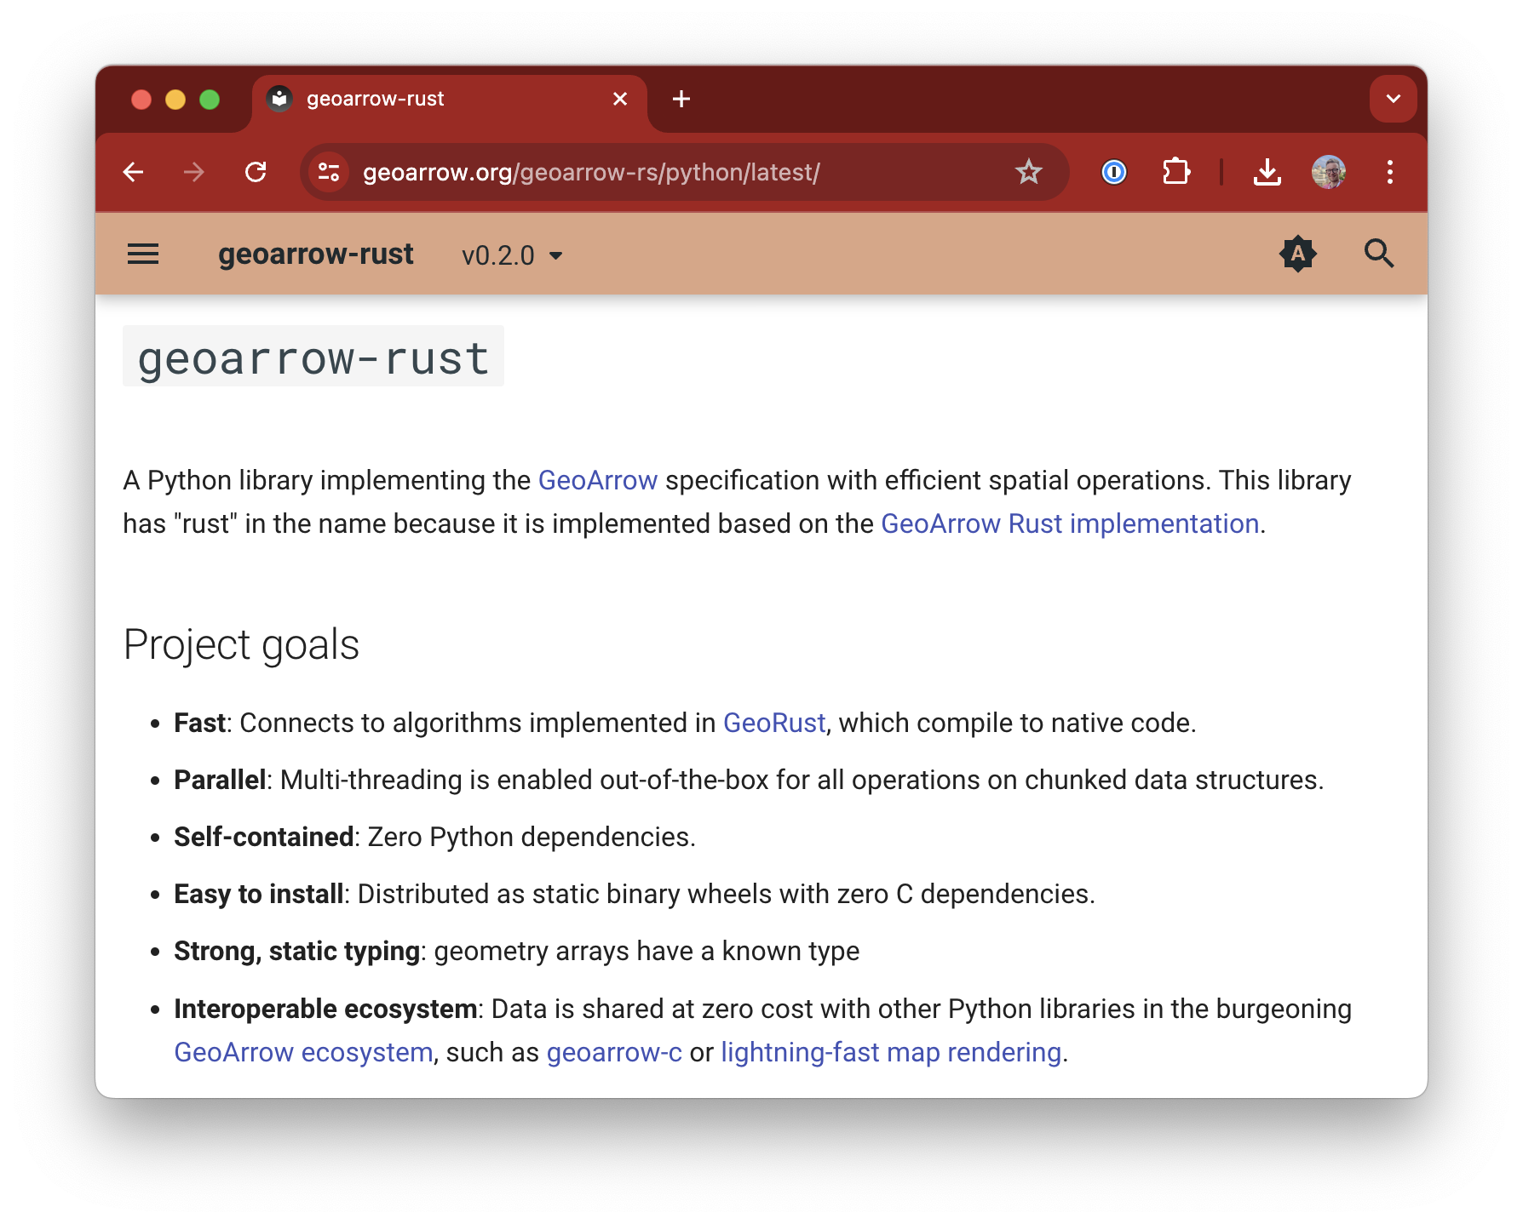
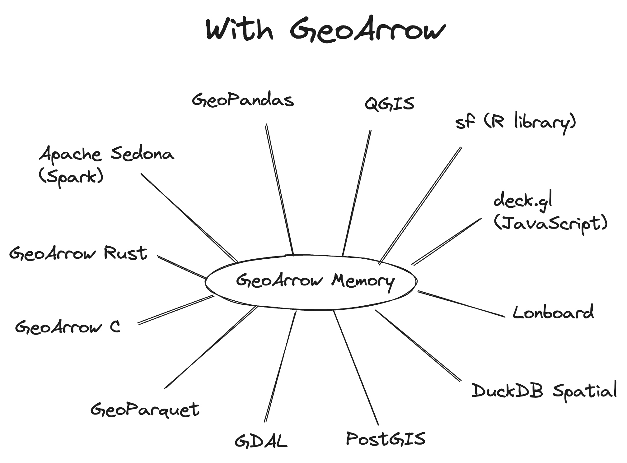
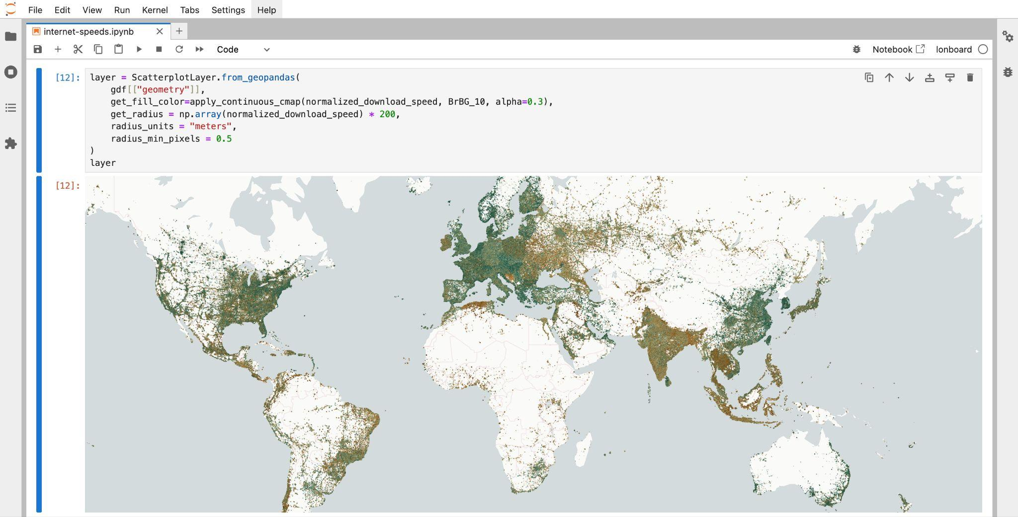
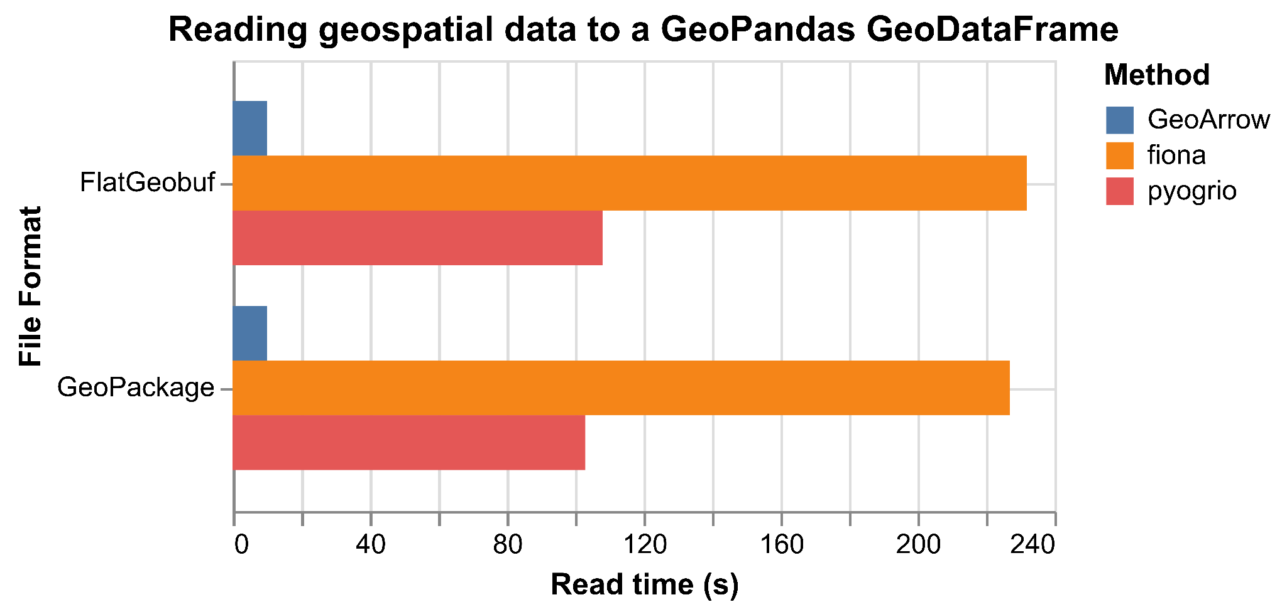
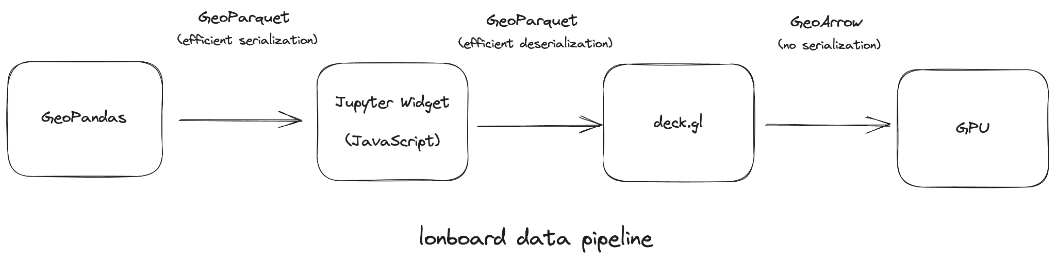


GeoArrow: Faster, more efficient geospatial data interchange.
GeoArrow: Zero-copy geospatial data sharing across Python, C, Rust, and JavaScript
Non-Cognitive Predictors of Student Success: A Predictive Validity Comparison Between Domestic and International Students
PRESENTER:
Kyle Barron
github.com/kylebarron
kylebarron.dev
Data protocols enable innovation by providing a stable boundary between data producer and consumer, allowing an ecosystem of libraries to reliably interoperate.
The existing __geo_interface__ protocol allows sharing GeoJSON-like objects via a class’s __geo_interface__ attribute. But this suffers from two performance flaws that cause massive overhead: it requires constructing a large number of Python objects and its memory layout differs significantly from what most geospatial libraries store internally.
GeoArrow is defined at the C level, avoiding any Python overhead and enabling zero-cost data sharing between Python and native code. Furthermore, because GeoArrow is also an efficient memory layout, the next generation of geospatial libraries can build on GeoArrow directly.
There’s been increasing adoption of GeoArrow in Python. GDAL’s GeoArrow support enabled a 23x speedup for reading into GeoPandas.
New libraries operate on GeoArrow directly. geoarrow-rust & geoarrow-c integrate to native code. Lonboard visualizes geospatial data 50x faster than existing alternatives.
Kyle Barron, Joris van den Bossche, Dewey Dunnington, & more
Notes:
Notes:
In Powerpoint, click View > Guides
Keep text within gutter guides.
Author list: Don’t split names onto two lines (e.g., “Jimmy [break] Smith”). If that happens, use a new line, unless you need the space. Bold the first names of anybody who’s presenting in person.
Intro/methods/result: Do not drop below font size 28, but if you have extra space, jack up the font size until the space is full.
Do not use color in the sidebars except in graphs/figures. It’ll pull attention from the center and slow interpretation for passersby.

